Slide 1
DSC 530 TERM PROJECT
Olufemi Obembe
https://github.com/fobembe/DSC530_Exploratory_Data_Analysis/blob/89b7660e4e309fbee9e766fea9930a4e91c89f17/Demand%20Forecasting%20Project.ipynb

Slide 2
Determinants of Demand using Contoso Dataset from SQL
Statistical Questions:
What is the impact of price on consumer demand?
What is the impact of income on consumer demand?
Does discounts have any impact on sales?
What role does occupation plays in sales?

Slide 3
Variables/Variables Selection
CustomerKey:
SalesQuantity:
UnitPrice:
Education:
Gender:
Yearly Income
Occupation:
Age:
Sum of Discount:

Slide 4
Variable Definitions
CustomerKey: The integer key ID of the customers
SalesQuantity: It is the aggregation of all the quantity of purchases by the customer
UnitPrice: It is the average price of all the products sold
Education: The educational qualifications of the customers
Gender: Male or Female
Yearly Income an Integer value of the total income of the consumer
Occupation: categorical variable identifying occupational class
Age: Integer value of the customers age
Sum of Discount: Total discount paid by the customer.

Slide 5
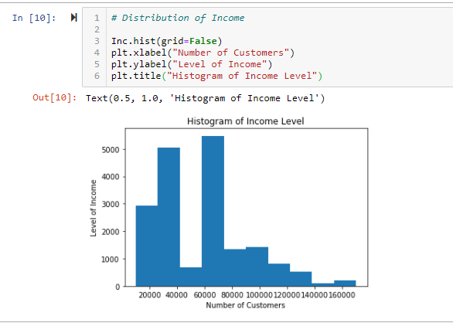
Customers’ Distribution of Income

Slide 6
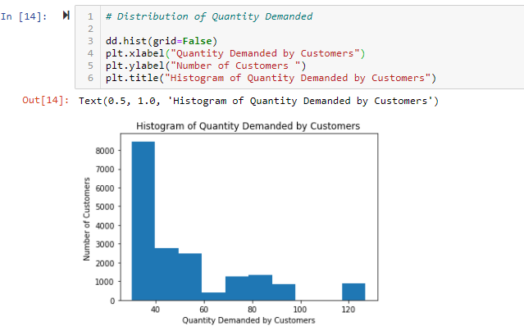
Customers’ Quantity Demanded

Slide 7
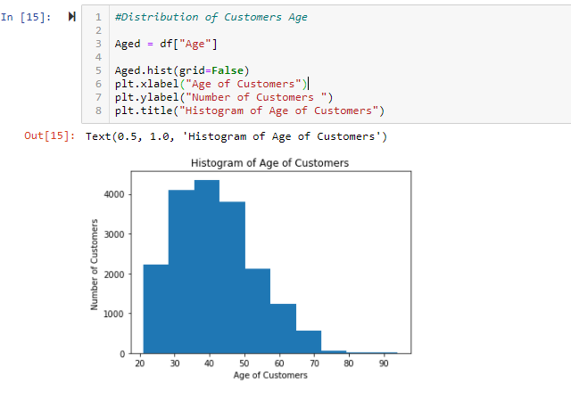
Customers’ Age Distribution

Slide 8
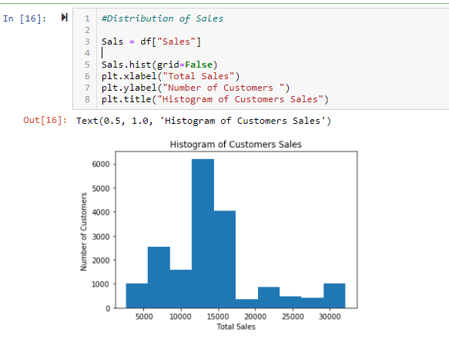
Customers Sales Distribution

Slide 9
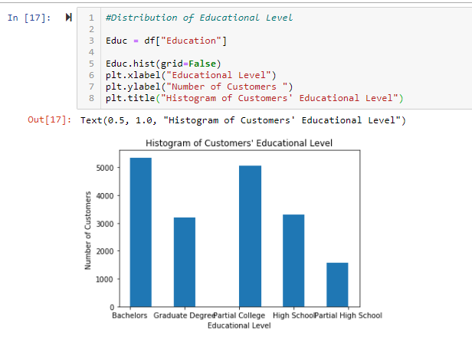
Customers’ Educational Levels

Slide 10
Outliers in the Dataset
Age—ages 80 and 90 years are conspicuous outliers in the dataset.
Demand—The quantity demanded of 120 is an outlier
Income—The income distribution between 140,000 and 160,000 are more of outliers.
All the variables are numeric, so I intend normalizing them using logarithmic transformation.

Slide 11
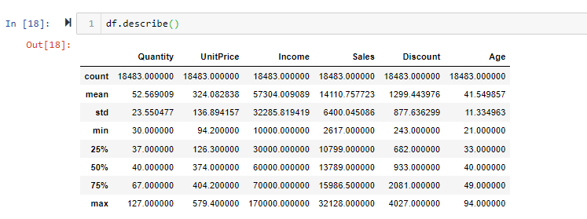
Other Descriptive statistics

Slide 12
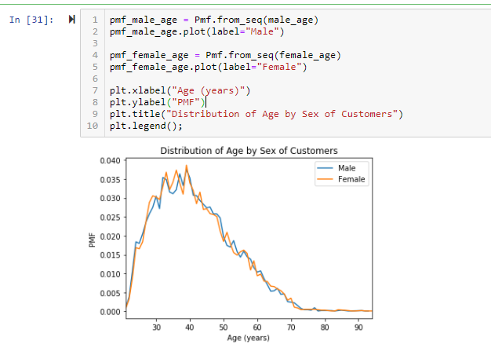
Age Distribution by Gender (PMF)

Slide 13
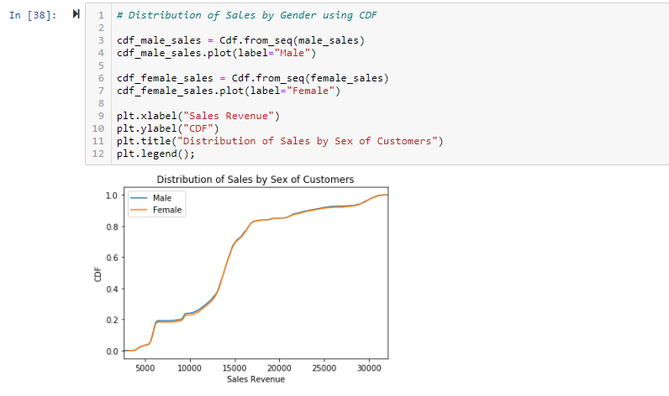
Sales Distribution by Gender (CDF)

Slide 14
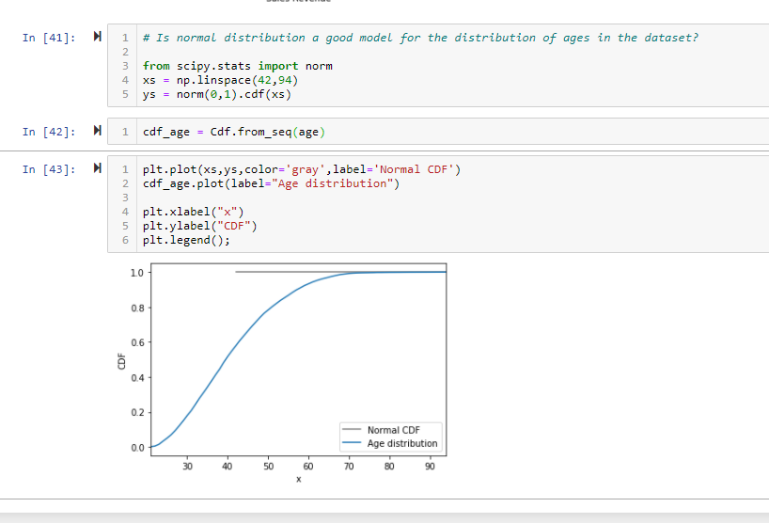
Analytical Distribution of Age.
The age distribution can be modelled using normal distribution.

Slide 15
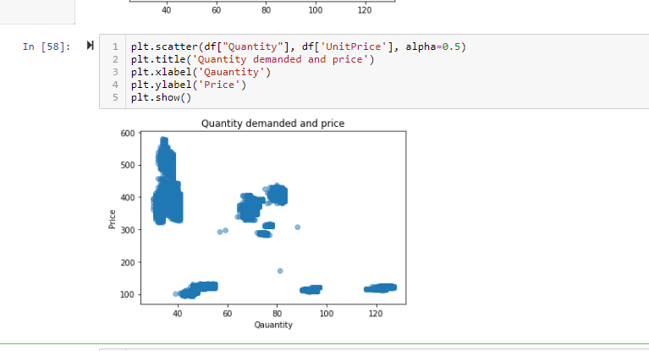
Scatter Plot of Quantity & Price
There is an inverse relationship between quantity and price

Slide 16
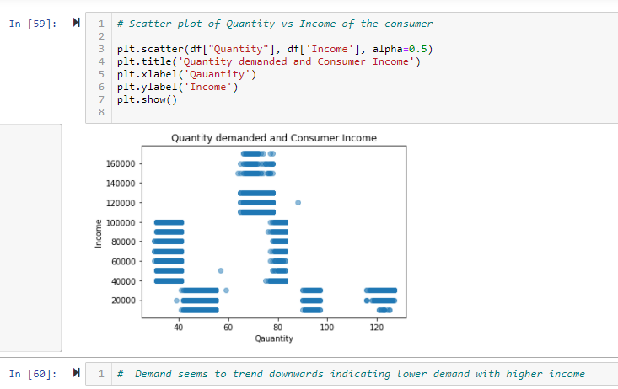
Scatter plot of Quantity vs Income

Slide 17
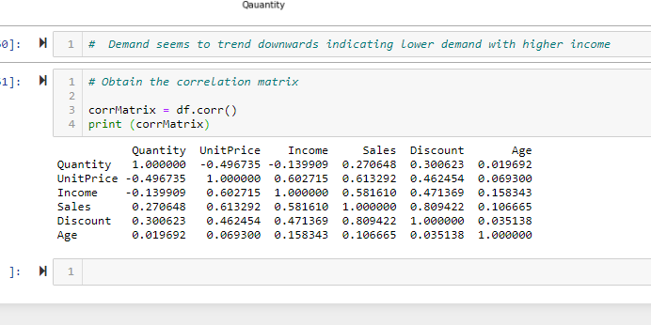
Scatter plot of Quantity and Income

Slide 18
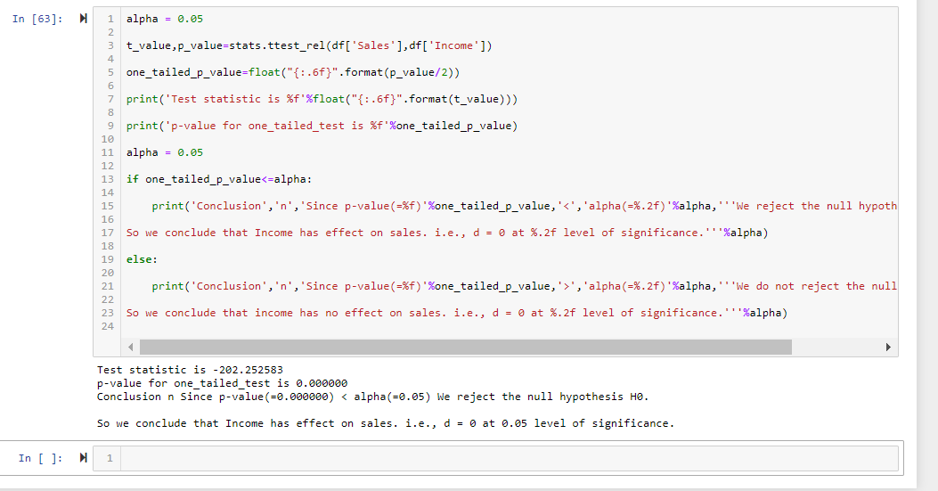
Test of Hypothesis: Income and Quantity Demanded

Slide 19
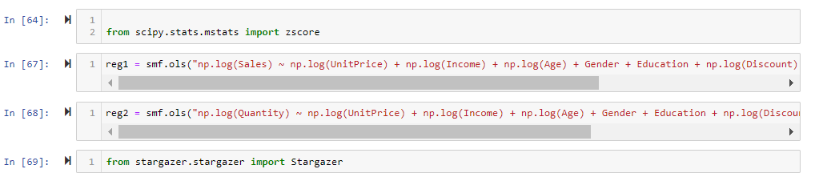
Regression Analysis on Determinants of Demand

Slide 20
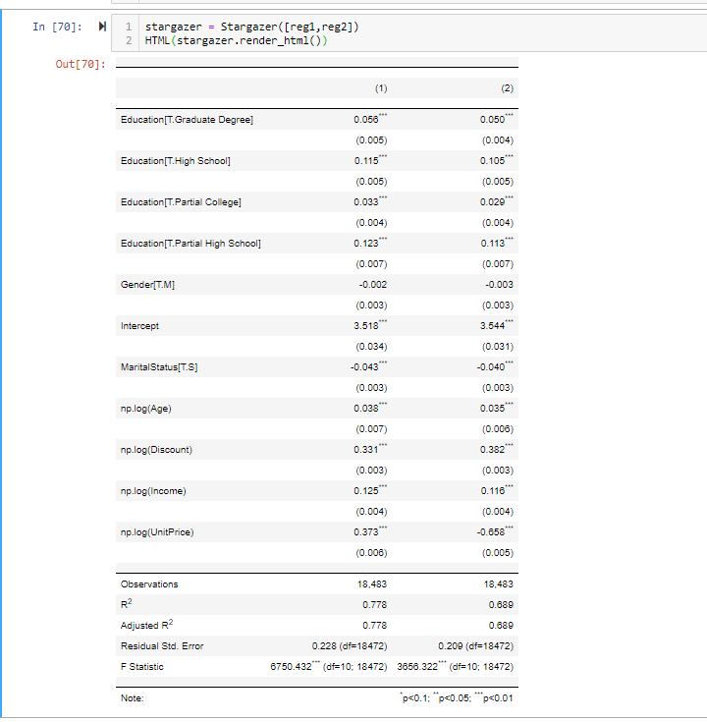
Results of Regression Analysis

